Slide 1

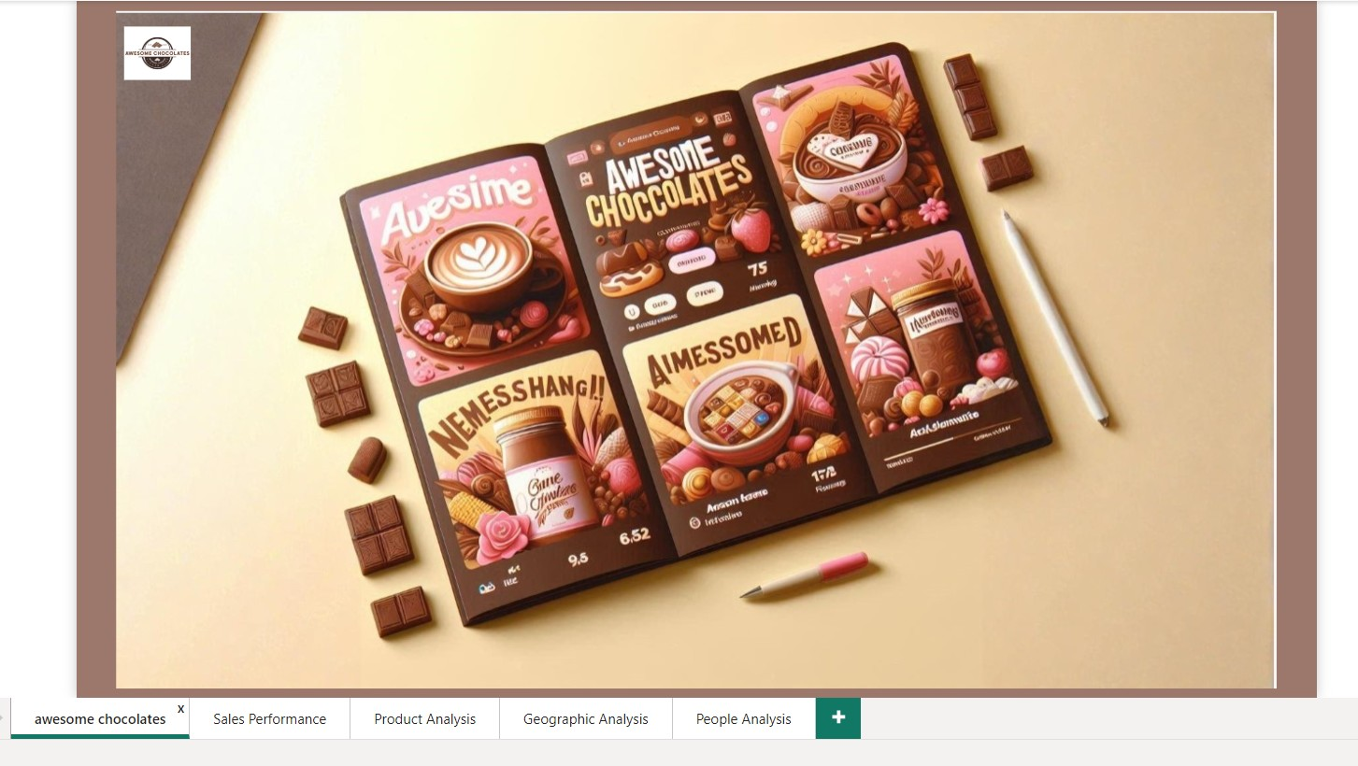

Slide 2
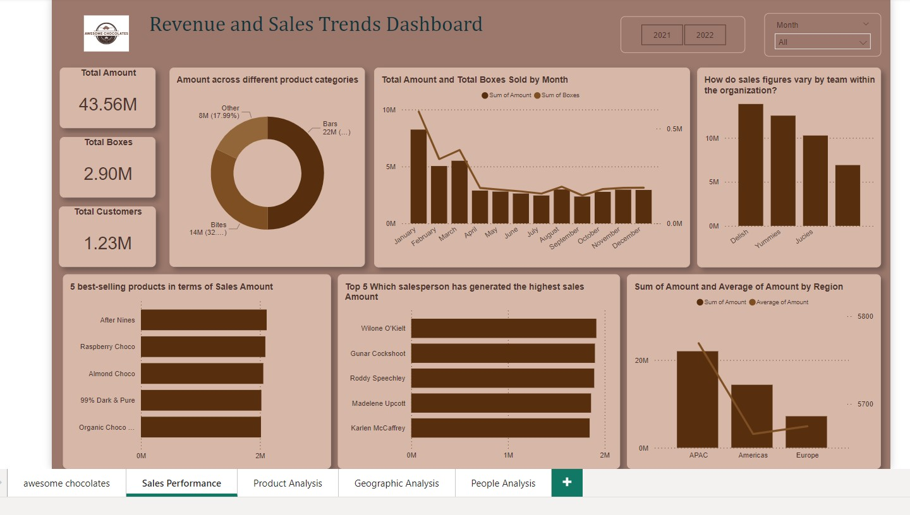

Slide 3
Insight
Overall Sales Insights:
The highest sales volume occurred in January to March, indicating seasonal spikes, possibly due to New Year or Valentine's Day.
Sales showed a decline from April to July, suggesting potential off-peak seasons.
The best performing quarter is 1.
Bars generated the highest revenue of $22M, (50%) making up a significant portion of total sales.
Regional Insights:
APAC is the leading region with the highest total sales amount of approximately $20M.
Europe showed the lowest sales but had a higher average revenue per sale, suggesting a focus on premium products.
Americas’ performance is moderate, showing potential for marketing efforts to boost sales.

Slide 4
Insight
Team Performance Insights:
Team Delish & Other has highest AOV in Europe
Team Delish emerged as the best-performing sales team, generating the highest sales revenue.
Team Juicies generated the least sales among the three teams, highlighting an area for sales strategy improvement.
Product Insights:
After Nines emerged as the most popular product, leading in revenue generation.
"After Nines," "Raspberry Choco," and "Almond Choco" are driving significant sales, making them critical for promotions.

Slide 5
Actionable Strategy
As sales is very high in Q1 so more focus on distribution in this time and other business operation like marketing, product inovaion, finding vender are doing in Q2,Q3,Q4
Doing influencer marking of "After Nines," "Raspberry Choco," and "Almond Choco" because they are driving most sales.
AOV was $ 35.41 by 1.23 million customer base. Use discounts or free samples to encourage repeat purchases and increase lifetime customer value.
Bars (50.46%) dominate sales so Expand the product range
Bites (32%) Bundle them with Bars to boost cross-sales.
Launch limited-edition versions of these products to create urgency and exclusivity

Slide 6
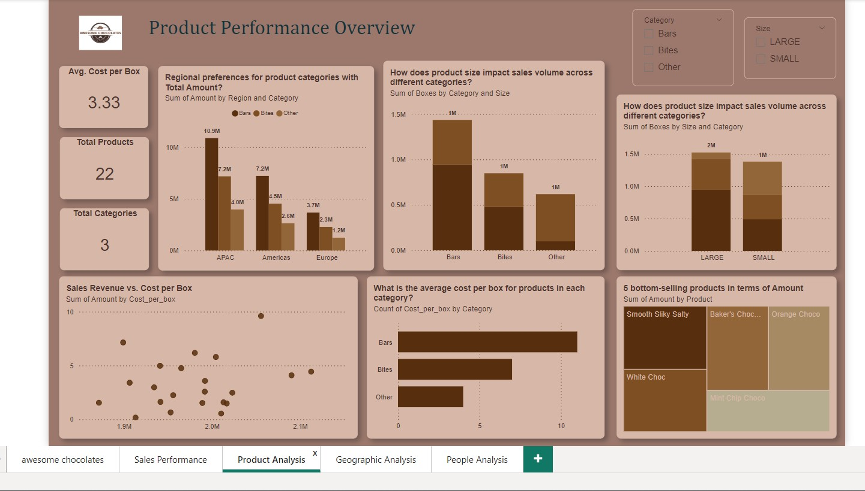

Slide 7
Insight
Actionable Strategy
Product Insights:
Bars dominate with the highest sales volume (21.7 M).
Large-sized products contribute twice as much to sales volume as small sizes.
Expand the Bars range with innovative flavors or health-focused options (e.g., vegan or low-sugar bars).

Slide 8
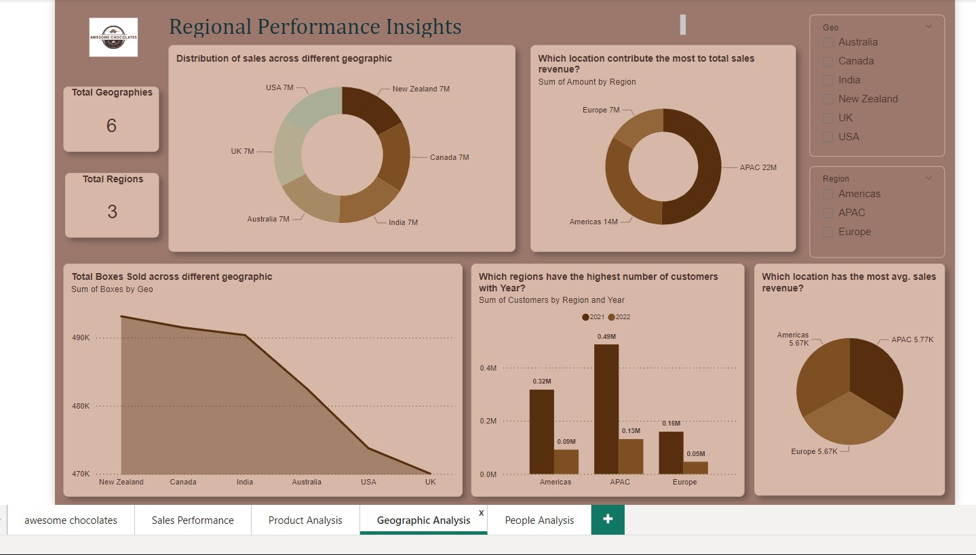

Slide 9
Insight
APAC contributes the most to total sales revenue and has the highest number of customers in both 2021 and 2022.
Sales are evenly distributed across key geographies like the USA, UK, Australia, New Zealand, Canada, and India.
APAC shows a consistent increase in customers.
New Zealand ranks highest in box sales but lags in total revenue.
The number of customers grew slightly in the Americas from 2021 to 2022.
APAC experienced the sharpest customer growth between 2021 and 2022.

Slide 10
Actionable Strategy
Identify growth opportunities in each geography by analyzing local sales trends and customer preferences.
Introduce new chocolate varieties and limited-edition products to keep the product lineup fresh and exciting. During (Q2, Q3, Q4)
Launch referral programs to encourage repeat purchases in APAC.
Introduce luxury packaging and exclusive collections.
Partner with local supermarkets for better shelf visibility.

Slide 11
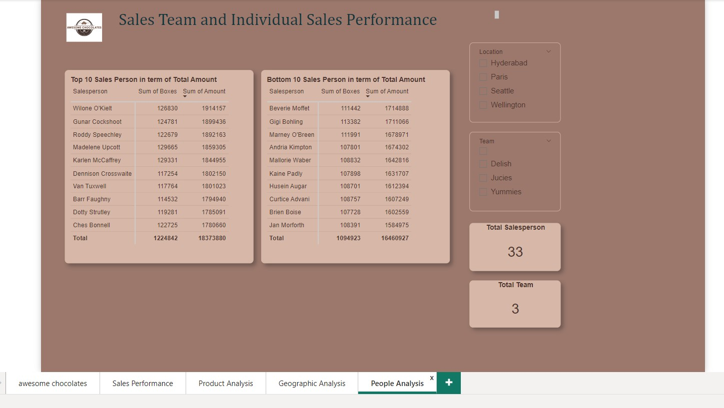

Slide 12

Thanks
Do you have any questions?
jatinbhavsar000@gmail.com
+91 9924750166

